Slide 1
More on UART Interrupts; System Calls
Reference on Interrupt Identification Register(IIR)
Page 17 of http://www.cs.umb.edu/~bobw/CS341/DataBook/c8652.pdf
Reference on System Calls
  text: Tanenbaum ch.1.6

Slide 2
How to Distinguish the Interrupts?
Method 1:
  Check the UART LSR to see if Receiver Data Ready (DR) bit or the Transmit Holding Register (THRE) bit is set. Then execute the corresponding Tx or Rx function.
Method 2:
  Check the UART Interrupt Identification Register (IIR)’s bits 1 and bit 2 to see what interrupt is active
  bit 2 bit 1 bit 0 Interrupt
  1 0 0 Rx Data Ready
  0 1 0 Tx Holding Reg Empty
  Note: Reading of IIR resets only the Tx Interrupt

Slide 3
Example of Using IIR
iir = inpt(baseport + UART_IIR);
switch (iir & UART_IIR_ID) { /* mask the 2-bit ID field */
case UART_IIR_RDI: /* it's a receiver int */
…. /* do Rx function */
case UART_IIR_THRI: /* it is a transmitter int */
…. /* do Tx function */
/* no need to turn off Tx int */
default:
…. /* do default function */
}
bit-wise operator

Slide 4
Pointers in Writing ISR
Don’t forget to ack the device.
Don’t forget to ack the PIC (send EOI)
You’re running with IF=0, so no need for cli(). Just leave interrupts off (iret will restore IF=1)
Do as little as possible in the int handler—you’re running on borrowed time, at least in the OS case.
You do need to use global variables to communicate with the program-level code. Interrupt handlers have no parameters.
The global data accessed both from interrupt handlers and program-level code causes “critical sections” in the program-level code, needing mutex protection, i.e., turning IF=0 during the critical section.
If more than one device is on the same IRQ, check the status of each and service all that are “ready” in the same interrupt. (If you do only one, you might miss the other, because the IRQ signals overlapped and appeared as only one to the PIC.) This point is relevant to the transmitter and receiver of a UART.

Slide 5
System Calls
Interface between the user program and the OS
User program executes a trap or system call instruction to transfer control to the OS
OS uses parameters passed to carry out the OS calls and return control to the user program at the instruction after the system call

Slide 6

Steps in Making a System Call
count = read (fd, buffer, nbytes);
Table of Pointers

Slide 7
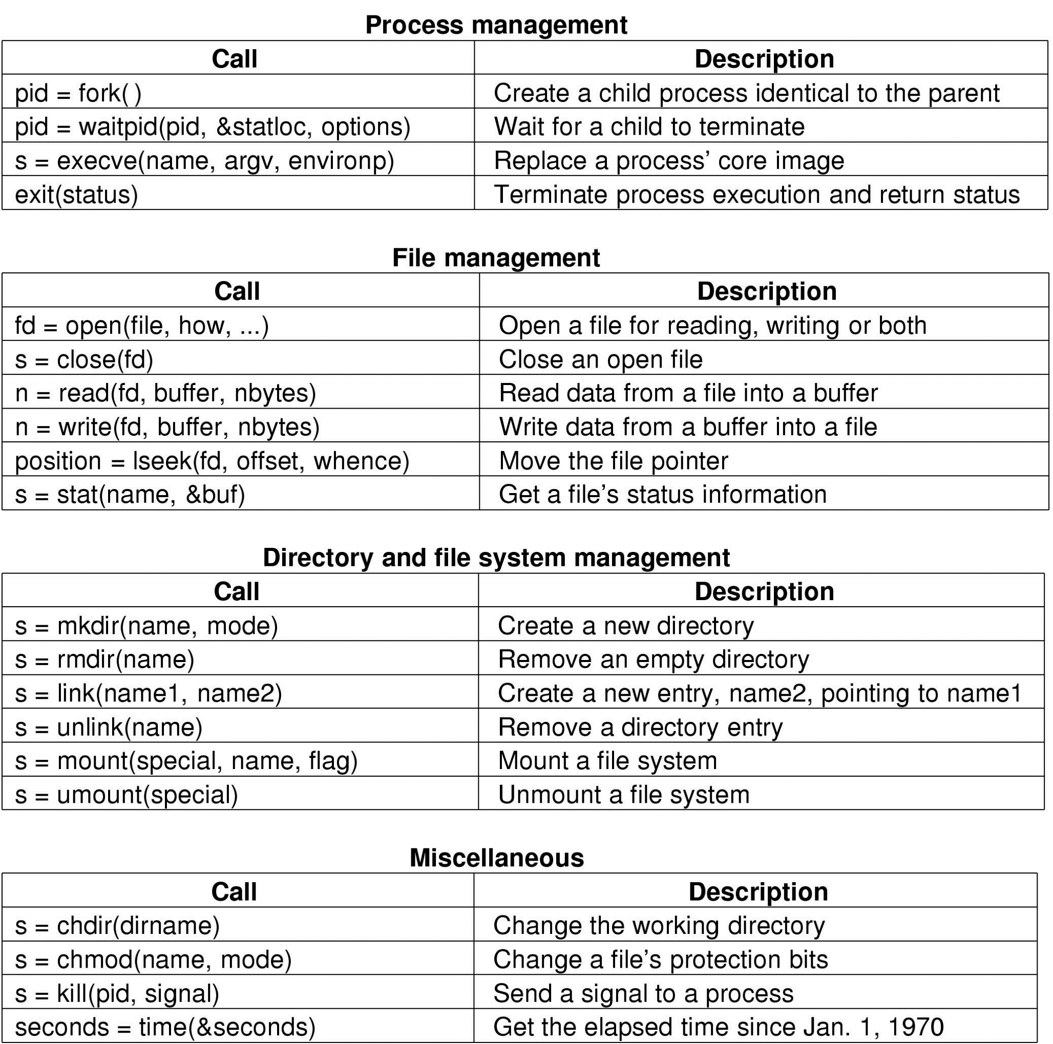
Major POSIX System Calls

Slide 8
More POSIX System Calls

Slide 9
System Calls for Process Management
fork() : create a new process in UNIX
After fork(), the original(parent) process and the copy(child) process go separate ways.
All variables have the same values at the time of fork(). Subsequent changes in one process do not affect the other.
If fork() is not successful, it returns -1 and no child process is created. If fork() is successful, it returns 0 to the child process and the child’s pid (some +ve number) to the parent process.
A process can get the parent’s pid using getppid() and its own pid using getpid().

Slide 10
fork() Code Examples
You can find some good code examples in:
http://www.cs.cityu.edu.hk/~lwang/fork

Slide 11
fork() Example 1:
#include <stdio.h>
main() {
int pid;
printf("I'm the original process with PID %d and PPID %d.\n", getpid(),getppid());
pid=fork(); /* Duplicate. Child and parent continue from here.*/
if (pid!=0) /* pid is non-zero, so I must be the parent */
{
printf("I'm the parent process with PID %d and PPID %d.\n", getpid(),getppid());
printf("My child's PID is %d.\n", pid);
}
else /* pid is zero, so I must be the child. */
{
printf("I'm the child process with PID %d and PPID %d.\n", getpid(),getppid());
}
printf("PID %d terminates.\n",pid); /* Both processes execute this */
}
$fork.exe ... run the program. I'm the original process with PID 13292 and PPID 13273.
I'm the parent process with PID 13292 and PPID 13273.
My child's PID is 13293.
I'm the child process with PID 13293 and PPID 13292.
PID 13293 terminates. ... child terminates.
PID 13292 terminates. ... parent terminates.

Slide 12
fork() Example 2:
int x_ext = 2; /* external var */
int main()
{
int x=6; /*local (automatic) variable */
if (fork()){
x++; x_ext++;
printf(“hello from parent, x=%d, x_ext=%d\n”, x, x_ext);
}
else printf(“hello from child, x=%d, x_ext=%d\n”, x, x_ext);
}
hello from parent, x=7, x_ext=3
hello from child, x=6, x_ext=2

Slide 13
System Calls for Process Management (cont’d)
execve(name, argv,environp): replace the current process image with one constructed from the contents of an executable file
  name: name of file to be exec.
  argv: pointer to argument array
  environp: pointer to environment array

Slide 14
execve Example: ls -l
#include <stdio.h>
int main() {
int status;
int ret = fork();
if(ret == 0)
{
char *params[3] = {"/bin/ls", "-l",0}; //cmd params filled
int res = execve( "/bin/ls" , params); //parameters for cmd
printf("\n child exiting (%d) .. \n", res); //on successful execution of cmd,
// this exit never appears
}
else
{
waitpid(ret, &status, 0);
printf("parent exiting\n");
}
return 1;
}

Slide 15
Details of the execve Program
For the command:
ls -l
The main program of ls has the declaration:
  For UNIX C: int main(int argc, char * argv[], char * envp[])
  For ISO C: int main(int argc, char * argv[])
  argc: no. of arguments
  argv: pointer to an array (argv[0] points to “ls”, argv[1] points to “-l” etc)
  envp: pointer to an array of strings of environment values
The child process executes the ls program and passes to it the argument -l
The parent process with waitpid(ret,…)waits for any child process to finish and return with
status=child’s exit status

Slide 16
Win32 APIs
Extremely large set, in thousands.
Some invoke system calls (using traps to the kernel). Some invoke library calls in user space. Varies with OS versions.
UNIX’s GUI (X windows and Motif) runs in user space. Many Win32 APIs dealing with GUI are system calls.

Slide 17
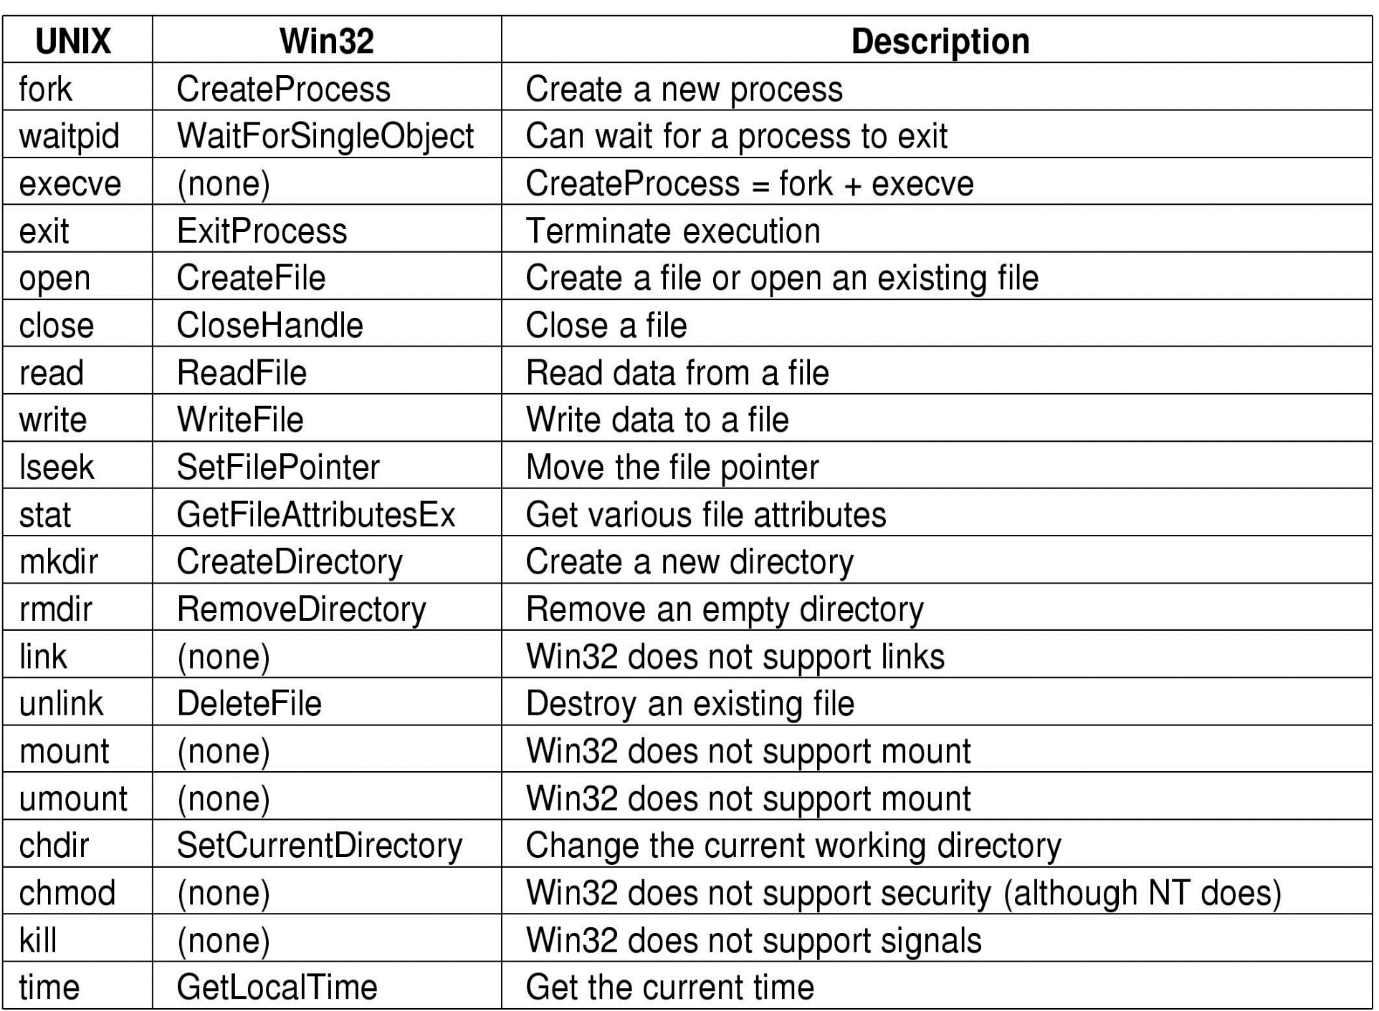
Comparisons of UNIX and Win32 API Calls

